Slide 1

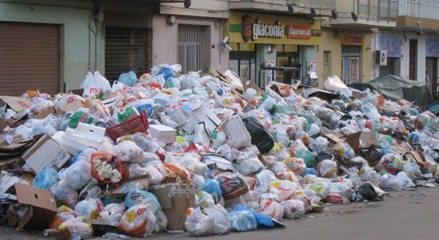
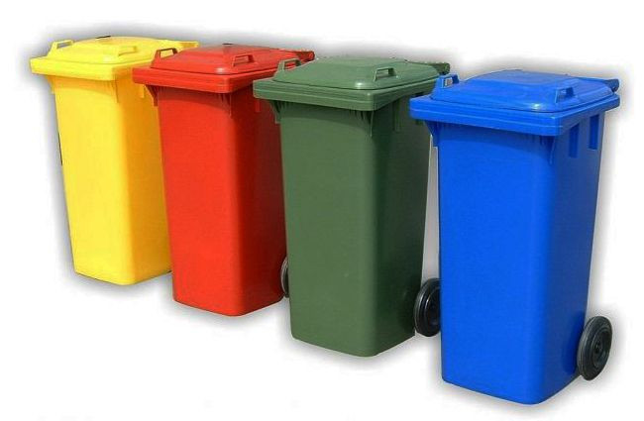
THE ALWAYS PROBLEM
WHAT WE ARE USED TO

Slide 2
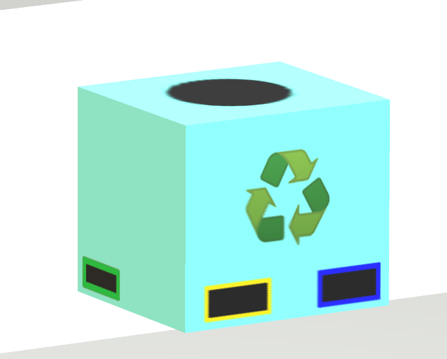
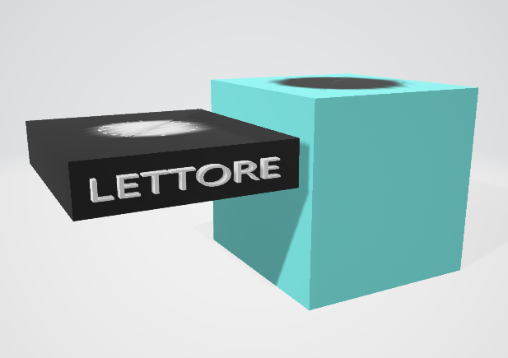
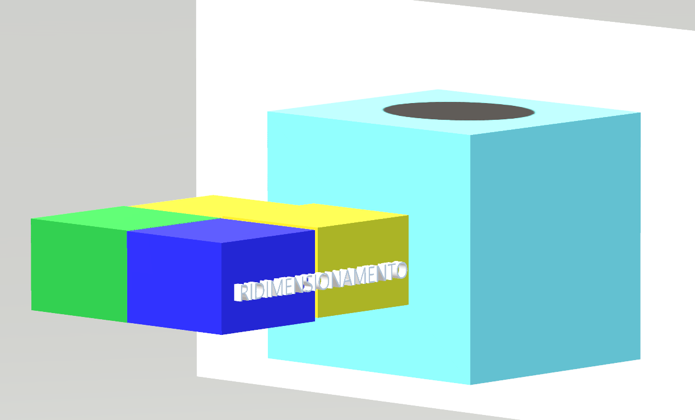
OUR PROPOSAL
ECOSIN: THE FUTURE AT HOME

Slide 3




THE TECHNOLOGIES THAT WE WILL USE
FRONT-END
BACK-END
FRANCESCO D’ERRICO
PAOLA BOCCHINO
GIOVANNI DE FILIPPO

